Slide 1
Application of Machine Learning in Medical Imaging (Chest Radiomics)
Arya Shukla
CS4973 - Responsible Machine Learning
12 December 2023

Slide 2
Table of Contents
01
02
03
04
05
06
Introduction
Methods
Background & Related Work
Results
References
Future Work & Limitations

Slide 3
Introduction
Medical Imaging - body is scanned to diagnose or monitor progress of disease
Bias in the Field
Lack of diversity in target pop. (understudied)
Inaccurate labeling of images
SDOHs
Motivation
Interest in healthcare & tech
Consistent attention to discrimination
Poor medical system
How might performance of a machine learning model demonstrate underdiagnosis for chest radiomics in protected classes?

Slide 4
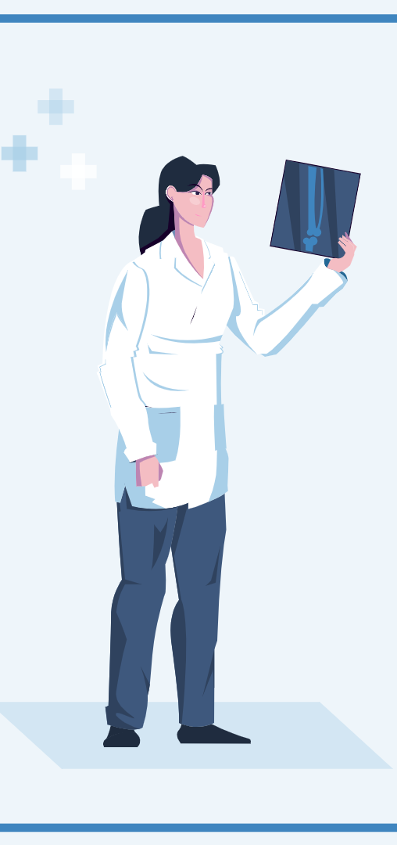
Background
AI in the Field
Pattern recognition
Increase in efficiency
Precision medicine
Constraints to Development
Extensive schooling for radiology
Need experts for accurate labeling
Biases in clinical records
Clinics practice in different ways
Image sharing (privacy constraints)
Notes:
Bias in clinical records: Nurses and physicians may write down notes in different ways depending on the patient (preconceived notions may cause notes to be unimportant)

Slide 5
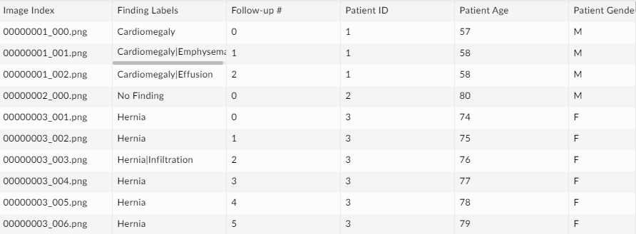
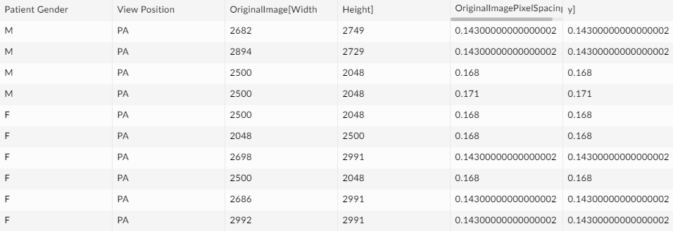
Related Work
Related Work
Read ~6 articles (2 GitHubs provided)
Focused on https://github.com/LalehSeyyed
Contained 3 preprocessed datasets
Beth Israel Deaconess Medical Center
Stanford Hospital
NIH Clinical Center
Dataset Information
Contained 14-15 diagnosis labels & “No Finding”
Issues with registration and agreement
Focused on smaller NIH image folder
NIH only contained frontal images
Image labels were found in additional dataset

Slide 6
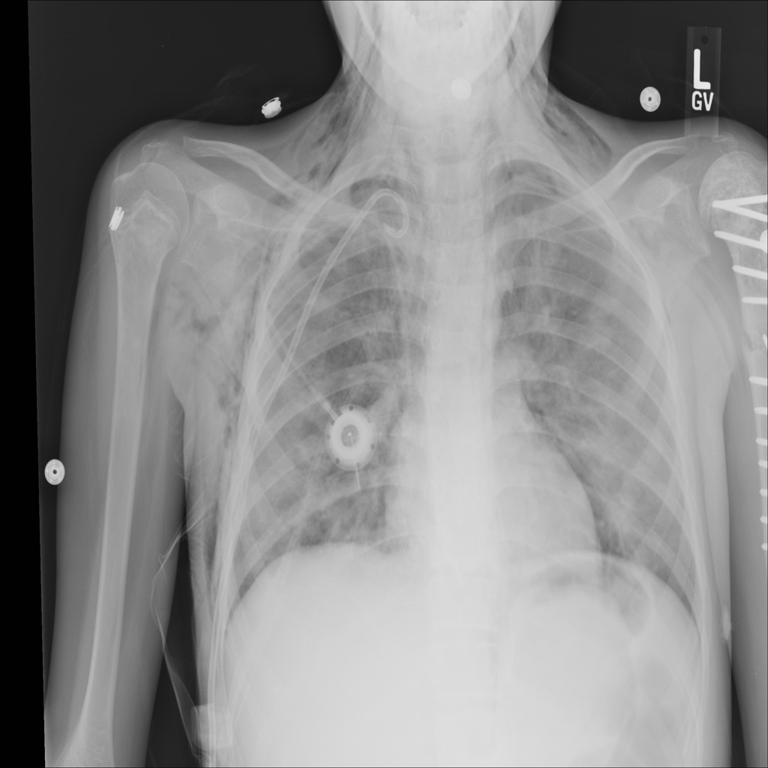
Methods
Had to pivot directions
Race labels were not in dataset
Available Protected Attributes: Patient Gender and Age
MOST IMPORTANT METRIC: FALSE NEGATIVE RATES
Captures underdiagnosis
Underdiagnosis
Falsely claiming a patient is healthy
Leads to no treatment when patient needs it
Potentially worse than misdiagnosis
Past studies have seen that there are higher rates of underdiagnosis for under-served populations

Slide 7
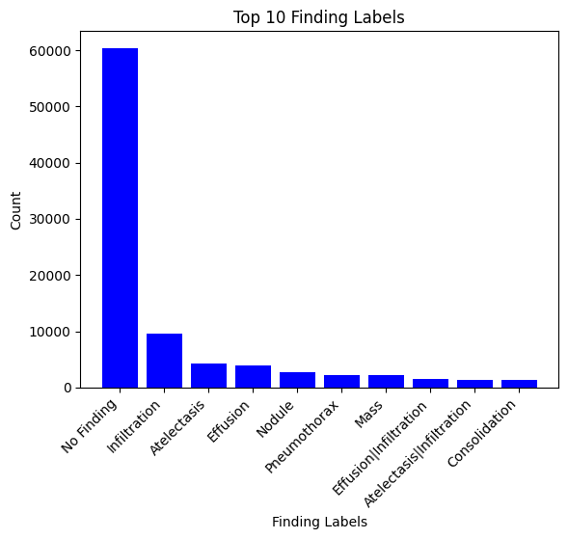
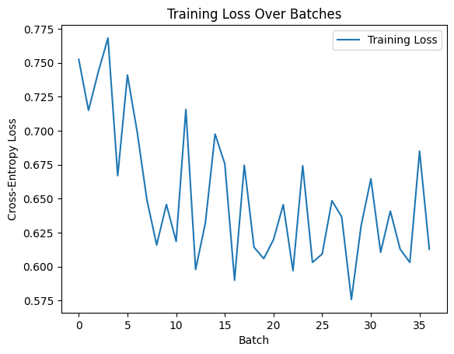
Methods
Preprocessed and cleaned datasets
Added age bins for later manipulation
bins = [0, 18, 30, 50, 100]
Took subset of DF involved in image folder
Split data into training and validation sets
Training
Used PyTorch framework to find 6000 training samples and 375 batches
Pretrained model “densenet” from NIH repo
Training model updated weights every loop
Used Cross Entropy loss as function
Small variation, general decrease
Figure 1. Breakdown of pathology count
Figure 2. Cross-Entropy loss
Notes:
Cross entropy loss is a good function for classification problems
Variation in cross-entropy comes from like .01 point difference but looks more volatile in the viz

Slide 8
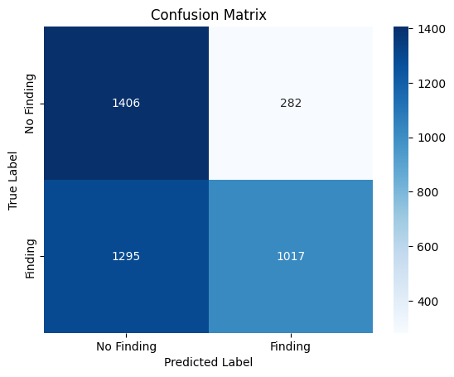
Results
Model Evaluation
Binary classifier using other attributes to predict
Ex. Image size, Patient gender/age
“No Finding” vs. “Finding”
Accuracy Scores
Overall: 0.60575
Per Gender
Accuracy for F: 0.61446
Accuracy for M: 0.59833
Per Age Group
Age Range: 0-18, Accuracy: 0.57526
Age Range: 18-30, Accuracy: 0.65485
Age Range: 30-50, Accuracy: 0.62127
Age Range: 50-100, Accuracy: 0.58157
Figure 3. Confusion matrix of classification
Notes:
Accuracy scores change every time we run it
Makes sense to choose these metrics (precision, accuracy, recall, F1 score) to evaluate because it is a binary classification problem that follows a SML format
Minimum age recorded in the dataset was 1 and maximum was 89
Accuracy scores rounded to 5 sig figs

Slide 9
Results
Most recently run code results
Interpretation
Precision: 52% correctly predicted as “No Finding”
Precision: 78% correctly predicted as “Finding
Recall: Identified correctly 83% of “No Finding” classes
Recall: Identified correctly 44% of “Finding” classes
FNR: 56% of actual “Finding” labels were incorrectly predicted as “No Finding”
High FNR - model missed a lot of the “Finding” labels in the data
Classification Report
precision recall f1-score support
No Finding 0.52 0.83 0.64 1688
Finding 0.78 0.44 0.56 2312
accuracy 0.61 4000
macro avg 0.65 0.64 0.60 4000
weighted avg 0.67 0.61 0.60 4000
False Negative Rate (FNR): 0.5601211072664359
Formula for FNR: FN / (FN + TP)

Slide 10
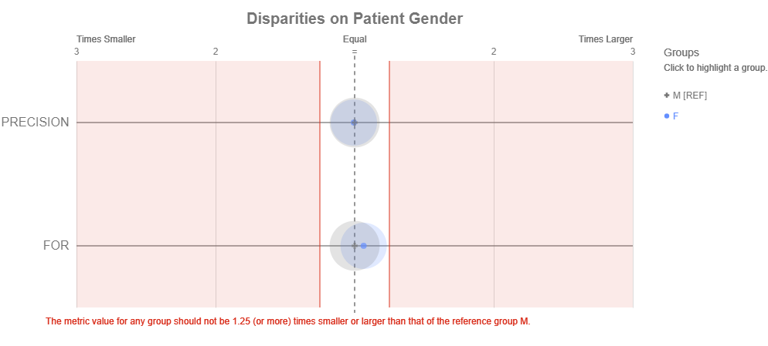
Results (Aequitas)

Slide 11
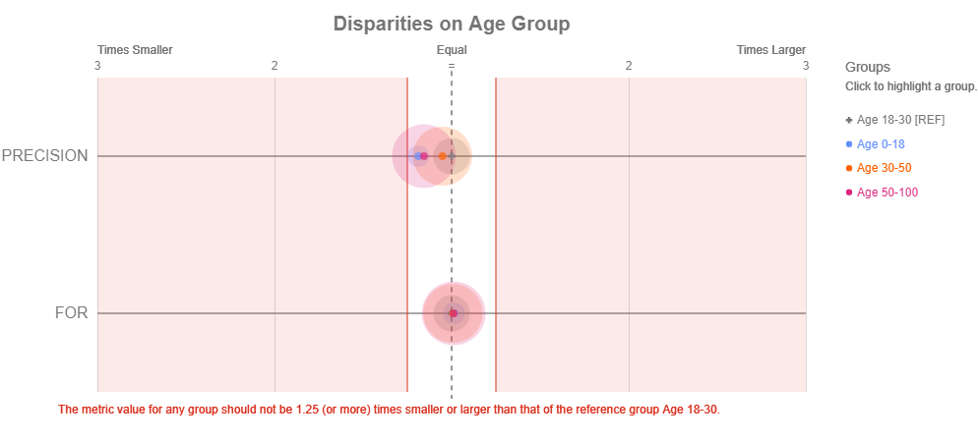
Results (Aequitas)
Notes:
Used 18-30 as reference group because they had the highest accuracy

Slide 12
Future Work/Limitations
Next Steps
Get access to all the datasets
Retrieve race labels
Look at intersectionality of age x gender (x race)
Solutions
Rebalance datasets (collect representative data)
Creation of a more diverse health database
All of Us Research Program
Consistency across technology
Implicit bias training
Notes:
Would not have known there was not a large correlation if we did not run the test
All of Us - invites participants from diff sub groups in the US to create diverse health database

Slide 13
References
[1] Judy Wawira Gichoya, Imon Banerjee, Ananth Reddy Bhimireddy, John L Burns, Leo Anthony Celi, and Li-Ching Chen. 2022. AI recognition of patient race in medical imaging: a modelling study. In The Lancet.
[2] Rachel Gordon. 2022. Artificial intelligence predicts patients’ race from their medical images. In MIT News.
[3] Maria Agustina Ricci Lara, Rodrigo Echeveste, and Enzo Ferrante. 2022. Addressing fairness in artificial intelligence for medical imaging. In Nature Communications.
[4] Laleh Seyyed-Kalantari, Haoran Zhang, Matthew McDermott, Iren Chen, and Marzyeh Ghassemi. 2022. Underdiagnosis bias of artificial intelligence algorithms applied to chest radiographs in under-served patient populations. In Nature Medicine.
[5] Xiaoli Tang. 2020. The role of artificial intelligence in medical imaging research. In National Library of Medicine.
[6] Stephen Waite, Jinel Scott, and Daria Colombo. 2021. Narrowing the Gap: Imaging Disparities in Radiology. In RSNA.

